Slide 1


Pitch Deck
Draw Your Own Line!

Slide 2

Problems
Travelers are required to use multiple platforms and applications for various tasks, ranging from flight reservations and accommodation planning to budget tracking and route creation. The lack of a single centralized solution makes the process complex and time-consuming.
There is no AI assistant that offers personalized recommendations based on users' interests and preferences, creates routes, and guides them through every stage of their journey. Existing applications provide static information and fail to deliver a personalized, dynamic experience.
Users need a digital travel journal where they can store the memories and statistics they gather throughout their trips, and share them on social media platforms. Current solutions do not adequately support the emotional and social aspects of travel.

Slide 3
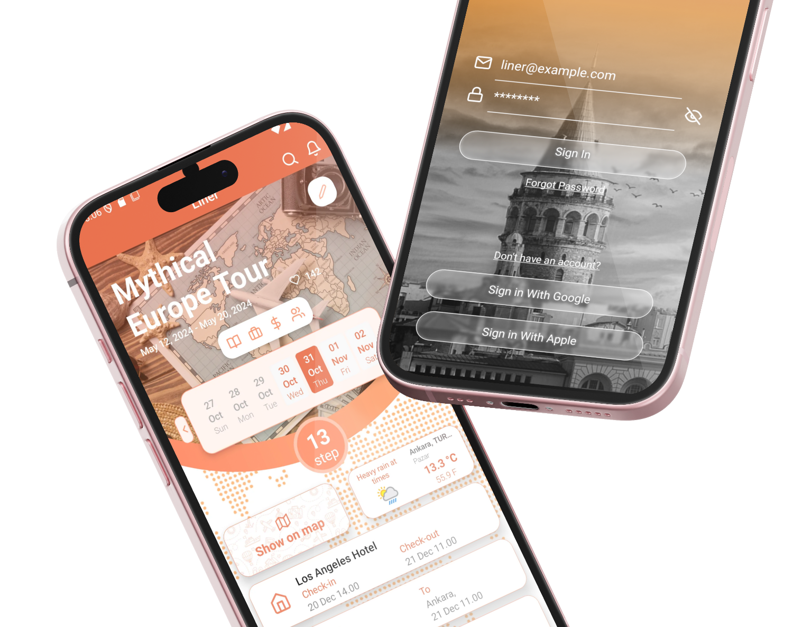
The First App a Traveler Will Download
We aim to become the single, most comprehensive solution that eliminates the challenges faced in travel planning, journey guidance, and memory storage, providing users with everything they need.

Slide 4

Market Share
After 3 years of full feature release, we aim to capture a 0.06% market share and generate a significant portion of our revenue by directly connecting tourism sector businesses' advertisements with their target audiences.
in million USD
Most recent update: Mar 2024
Source: Statista Market Insights

Slide 5

Target Market
2 billion
Total Addressable Market (TAM)
800 million
Serviceable Available Market (SAM)
1.2 million
Serviceable Obtainable Market (SOM)

Slide 6

Target Audience
Primary Target Audience: Trip Planners
Individuals planning to travel, in need of tools for route planning, accommodation and transportation arrangements, budget management, and exploration.
Secondary Target Audience: Travelers and Content Creators
Adventurers who not only want to experience their trips but also share their experiences, discover new routes through social media, and get inspiration from other travelers' recommendations.
Tertiary Target Audience: Tourism Sector and Businesses
Businesses within the tourism sector, such as hotels, restaurants, tour guides, and other tourism-related companies, aiming to reach their target audiences directly.

Slide 7

Our Differentiators
AI-powered route creation and recommendation system
CarPlay and smartwatch support
Automatically generated routes in offline mode
Group organization tools
Memory journal outputs compatible with social media

Slide 8



2025 Timeline
Q1
Q2
Q3
Q4
Prototype
MVP
R&D
Revenue Models
Investment for prototype completion and workforce
MVP completion, market launch, and company formation
R&D activities and team expansion
Agreements with stakeholders and diversification of revenue models

Slide 9




Meet Us
Berkay Güneş
Marketing & Design
Murat Can Baştuğ
Team Leader
Doğukan Durgun
Software Developer
Yusuf Diner Yıldız
Software Developer

Slide 10
Conclusion and Call for Investors
The most outstanding feature of our project is its ability to adapt to innovative technologies by creating a personalized artificial intelligence model that can provide tailored suggestions for users. It also utilizes IoT technology in conjunction with factors such as wearable technology and CarPlay, and most importantly, it was born out of the specific needs of travelers.
Our detailed research for this project, which requires a serious R&D process focused on artificial intelligence, shows that we will reach significant profitability within a maximum of 3 years. During this period, we are seeking an investment of $175,000 in exchange for 15% of our company’s shares in the first investment round to develop our application in the best possible way and strengthen our market share.
The total investment required is $350,000, and in the next phase, during the second investment round, we plan to secure the remaining funding in exchange for an additional 10% equity. However, we are open to different investment models based on strategic partnerships and mutual negotiations during the investment process.
As Apphona, we believe this project offers not only a financial investment but also a strategic opportunity in a rapidly growing sector. We invite investors who share our vision to join us on this exciting journey.

Slide 11





Contact Us
Contact Information
+90 536 966 60 09
Gmail
info.line@apphona.com
Website
https://www.apphona.com

